Slide 1
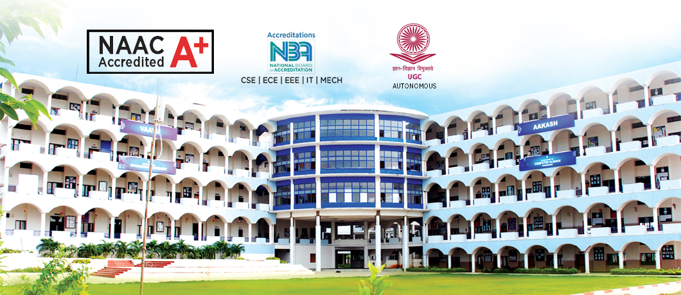
BASIC CIVIL AND MECHANICAL ENGINEERING

Slide 2
SYLLABUS
Course Objectives:
Get familiarized with the scope and importance of Civil and Mechanical Engineering in different sectors and industries.
Introduce the preliminary concepts of Building Planning, Building Construction, Materials and the related tests.
Acquire preliminary knowledge of surveying and understand the importance of the quality of the drinking water.
Explain different engineering materials and manufacturing processes.
Provide an overview of different thermal and mechanical systems, introduce basics of robotics and its applications.

Slide 3
Course Outcomes:
On completion of the course, the student should be able to:
Understand various sub-divisions of Civil Engineering and to appreciate their role in ensuring better society.
Know the concepts of surveying and to understand the measurement of distances, angles and levels through surveying.
Realize the importance of Transportation in nation's economy and the engineering measures related to highways in terms of geometrics.
Understand the importance of water resources and storage structures so that the social responsibilities of water conservation will be appreciated.
Understand the different manufacturing processes and explain the basics of thermal engineering and its applications.
Describe the working of different mechanical power transmission systems and power plants; learn basics of robotics.

Slide 4
UNIT I
Basics of Civil Engineering: Role of Civil Engineers in Society- Various Disciplines of Civil Engineering- Structural Engineering- Geo-technical Engineering- Transportation Engineering - Hydraulics and Water Resources Engineering - Environmental Engineering-Scope of each discipline - Building Construction and Planning- Construction Materials-Cement - Aggregate - Bricks- Cement concrete- Steel. Introduction to Prefabricated construction Techniques.
UNIT II
Surveying: Objectives of Surveying - Horizontal Measurements – Angular Measurements-Introduction to Bearings levelling instruments used for level ling-Simple problem son leveling and bearings-Contour mapping.

Slide 5
UNIT III
Transportation Engineering :Importance of Transportation in Nation's economic development- Types of Highway Pavements- Flexible Pavements and Rigid Pavements-Simple Differences. Basics of Harbour , Tunnel, Airport, and Railway Engineering
Water Resources and Environmental Engineering: Introduction, Sources of water- Quality of water- Specifications- Introduction to Hydrology– Rain water Harvesting-Water Storage and
Conveyance Structures (Simple introduction to Dams and Reservoirs).

Slide 6
Textbooks:
G. Shanmugam and M.S.Palanisamy, Basic Civil and the Mechanical Engineering, Tata Mcgraw Hill publications (India) Pvt. Ltd.
Basic Civil Engineering, S.S. Bhavikatti, New Age International Publishers.
Engineering Materials, Dr. S.C. Rangwala, Charotor Publishing House.
Highway Engineering, S.K.Khanna, C.E.G. Justo and Veeraraghavan, Nemchand and Brothers Publications.
Irrigation Engineering and Hydraulic Structures - Santosh Kumar Garg, Khanna Publishers, Delhi.
Building Construction, Dr. B. C. Punmia, Lakshmi Publications, Delhi.
Reference Books:
Surveying, Vol- I and Vol-II, S.K. Duggal, Tata McGraw Hill Publishers.
Hydrology and Water Resources Engineering, Santosh Kumar Garg, Khanna Publishers, Delhi.

